Slide 1
Statistics 367-1-4361 Hierarchical Models
Opher Donchin

Slide 2
7A Review

Slide 3
7B Hierachical Models

Slide 4
Grouped data is common
Multiple drugs applied to different cell cultures
Each subject does multiple sessions of EEG
And each session has multiple trials
Animals are divided into treatment groups
And each animal is measured at multiple time points
Each subject tries multiple protheses
Each prostethic is evaluated over several days
On every day there are several trials

Slide 5
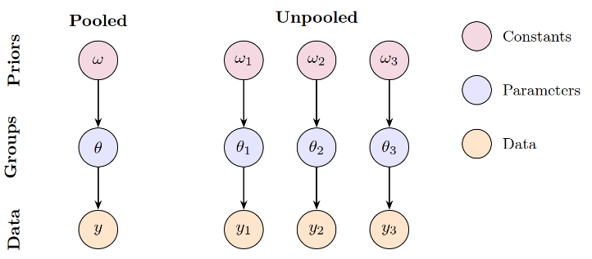
Two extreme options
Pretend groups don’t exist
Make ‘pooled’ parameter estimates
Only one set of group parameters
Pretend groups are unrelated
Make ‘unpooled’ parameter estimates
Each group has independent parameters

Slide 6
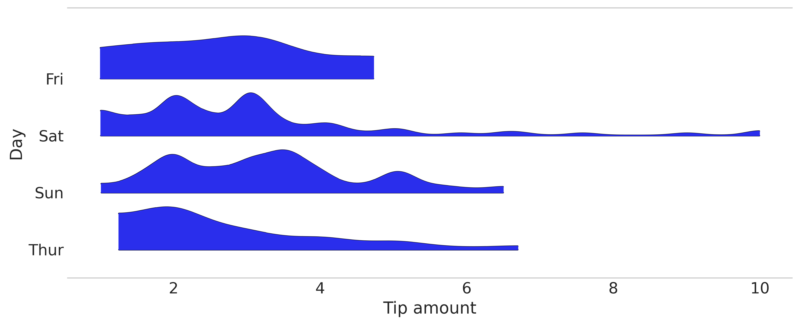
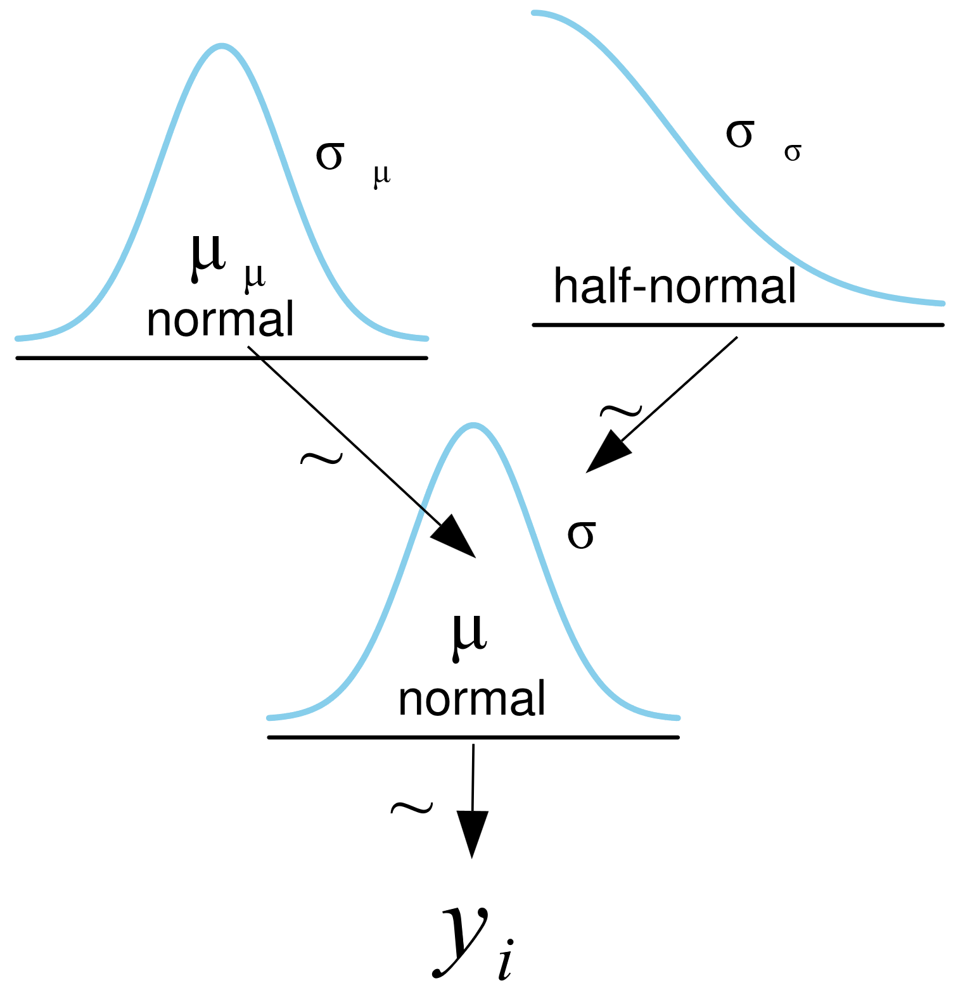
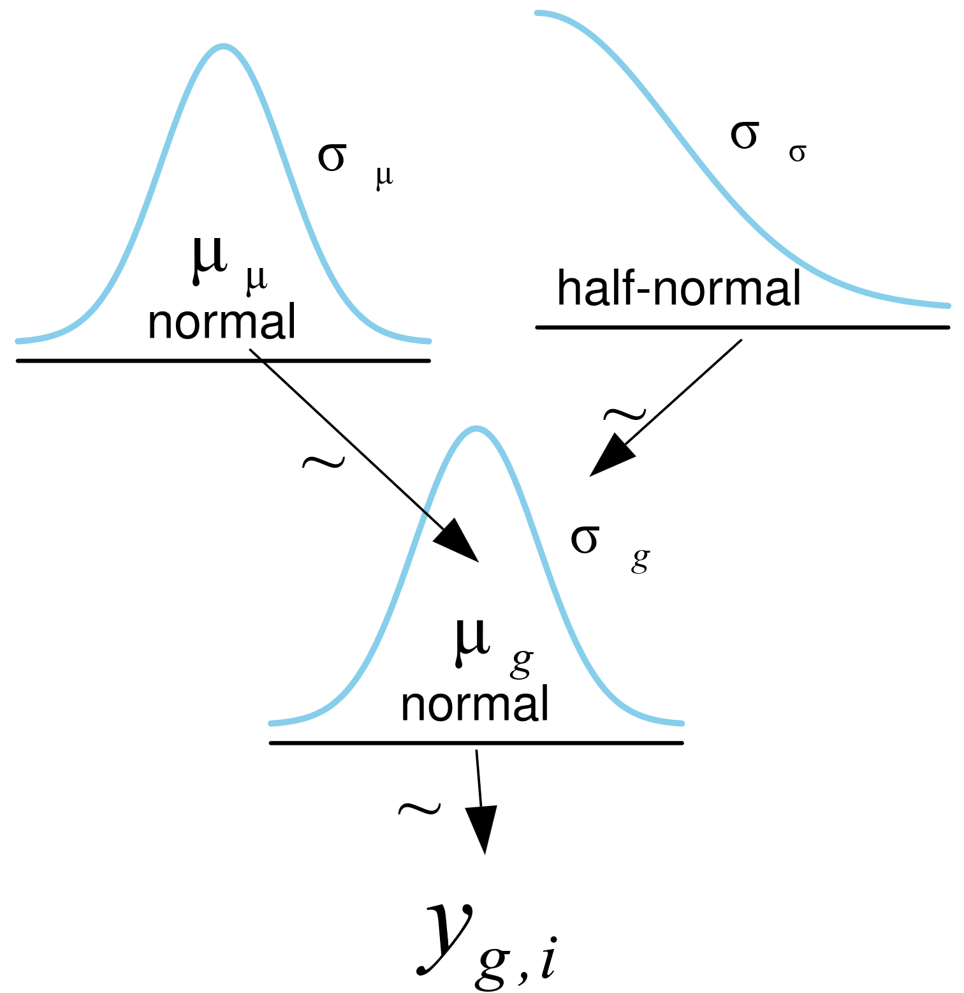
Tips data
4 groups
Pooled and unpooled models are possible
The unpooled model seems to have 1 prior
But it is really 4 identical priors
Pooled
Unpooled

Slide 7
Pooled and unpooled PyMC
PyMC would accept a vector for sigma in the HalfNormal
They really are different priors
Pooled
Unpooled
with pm.Model(coords=pooled_coords) as pooled_model:
μ = pm.HalfNormal("μ", sigma=5)
σ = pm.HalfNormal("σ", sigma=1)
y = pm.Gamma("y", mu=μ, sigma=σ, observed=tip, dims="data")
with pm.Model(coords=unpooled_coords) as unpooled_model:
μ = pm.HalfNormal("μ", sigma=5, dims="days")
σ = pm.HalfNormal("σ", sigma=1, dims="days")
y = pm.Gamma("y", mu=μ[idx], sigma=σ[idx], observed=tip, dims="days_flat")

Slide 8
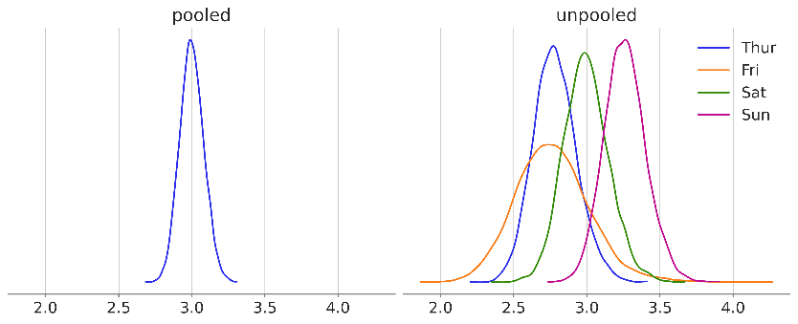
Pooled and unpooled posteriors
Pooled model
Less uncertainty
Shared information
Unpooled model
Parameters for each group
Information is not pooled

Slide 9
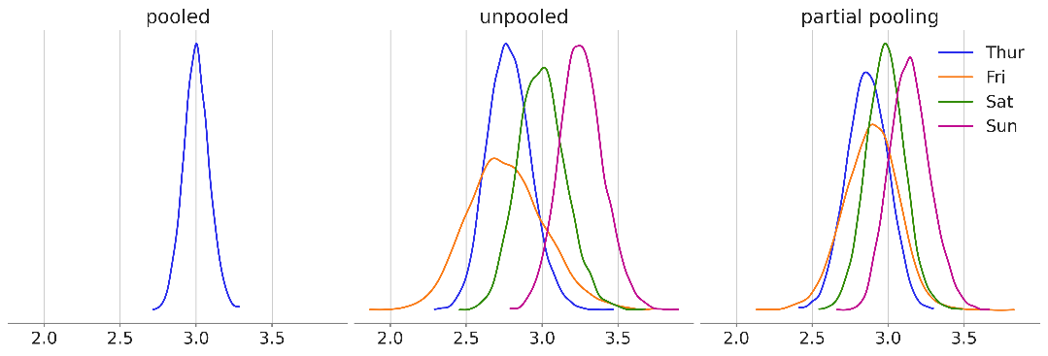
Partial pooling
Information sharing across groups
Separate parameters for each group

Slide 10
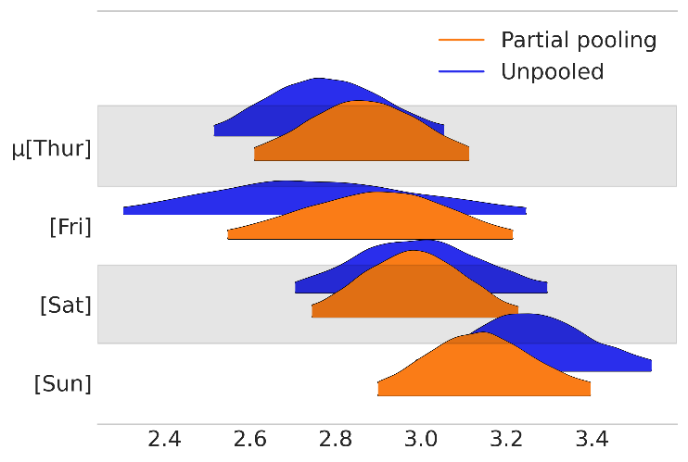
Compre the results
az.plot_forest([idatas["unpooled"], idatas["partial pooling"]],
var_names="μ", model_names=["Unpooled", "Partial pooling"],
kind="ridgeplot",
combined=True, figsize=(6, 4))
Partial pooling:
More narrow HDIs
Closer together

Slide 11
Partial pooling through hierarchical models

Slide 12
7C Hierarchical models in PyMC

Slide 13
7D Benefits and pitfalls

Slide 14
7E Bayesian workflow

Slide 15
7F Hierarchical regression

Slide 16
7G Group-level effects

Slide 17
7H Bayesian workflow

